Slide 1
Overview
What is the width of the depletion region? How does it relate to the dopant concentration?
What is built-in voltage?
What happens when we apply voltage to the p-n junction?
What is forward and reverse bias?
What is the current-voltage characteristic for the p-n junction diode?

Slide 2
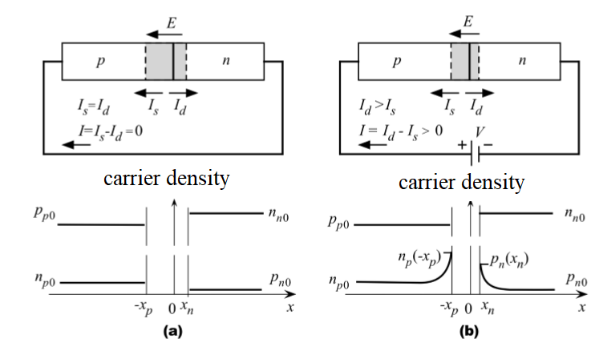
a) Unbiased p-n junction b) forward biased p-n junction

Slide 3

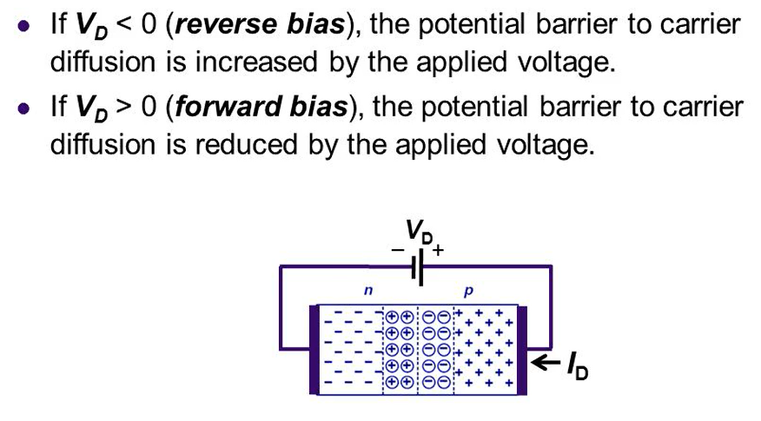

Slide 4
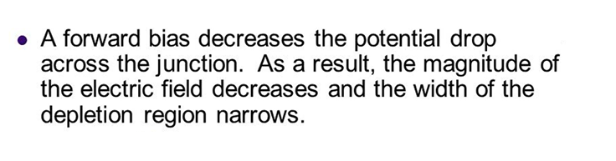
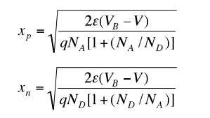
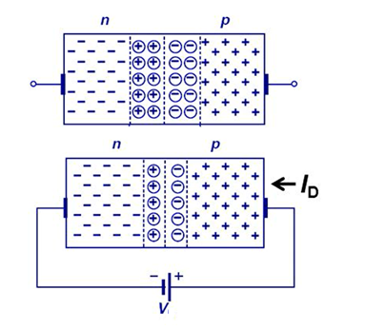
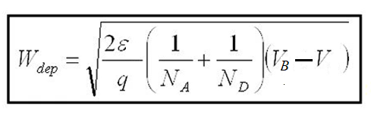

Slide 5
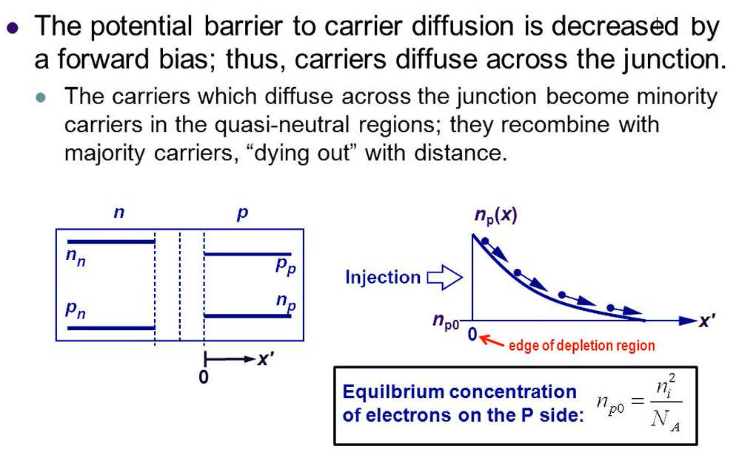

Slide 6
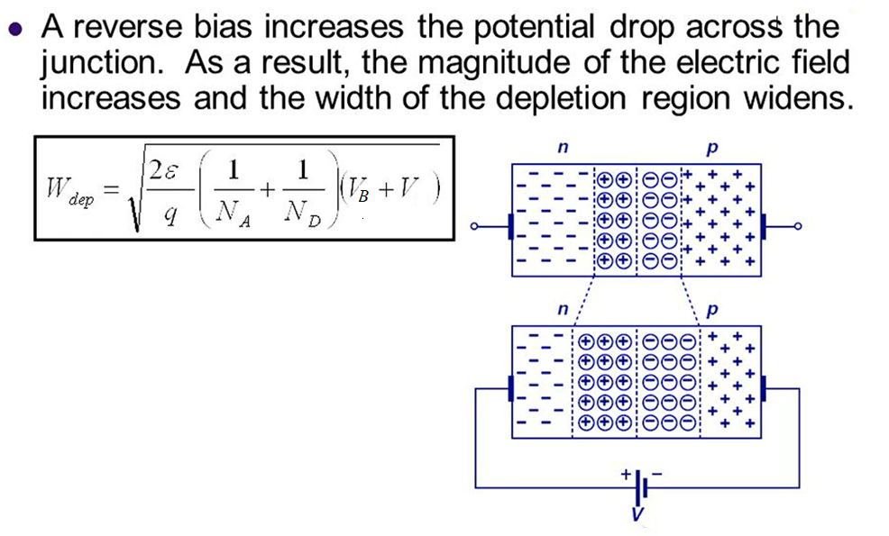
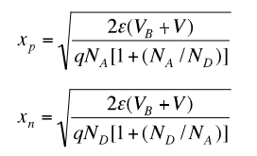

Slide 7
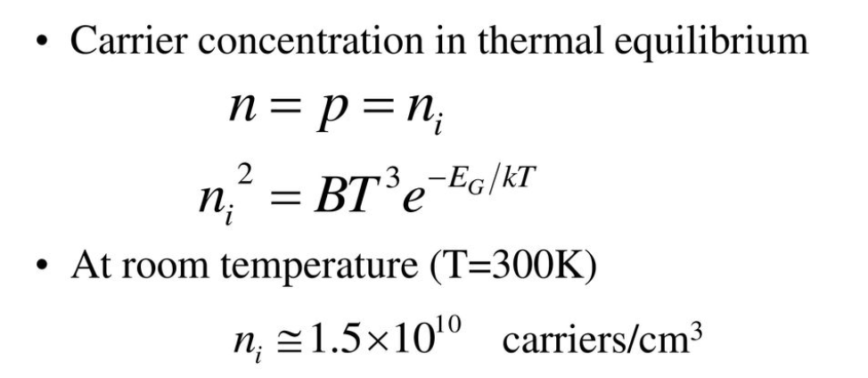
Reminding

Slide 8
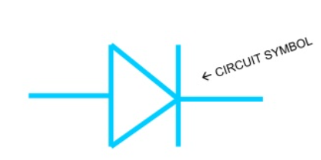
What is a Diode
A semiconductor device with two terminals allowing the flow of current in one direction only.

Slide 9
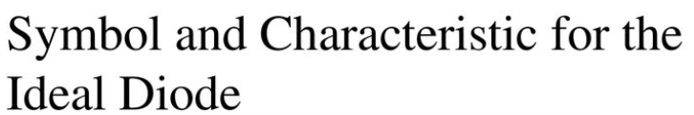
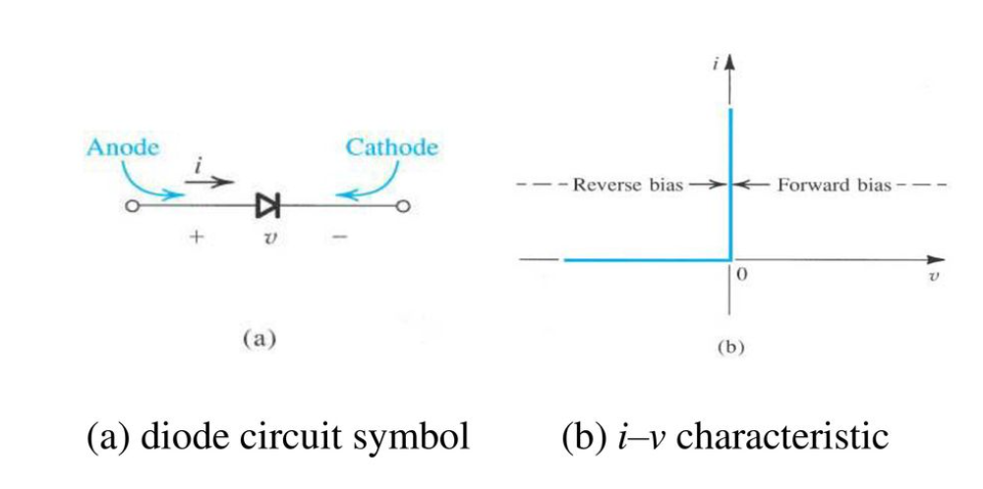

Slide 10
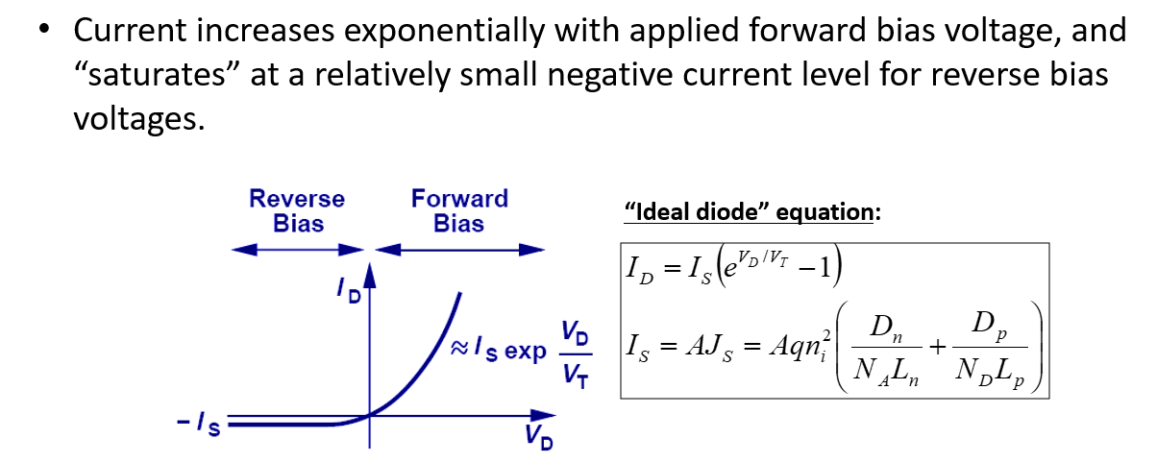
The current increases exponentially with the voltage applied in the forward direction.
The current remains at a very small current level for the voltage applied in the reverse direction and is referred to as the " IS" saturation current or leakage current.

Slide 11
I_{s} is the saturation current ~10 ⁻¹⁴
V_{d} is the diode voltage
n – emission coefficient (varies from 1 - 2 )
k = 1.38 × 10^{–23} J/K is Boltzmann’s constant
q = 1.60 × 10^{–19} C is the electrical charge of an electron.
At a temperature of 300 K,

Slide 12
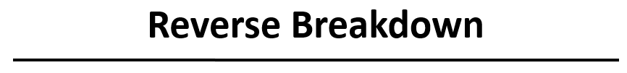
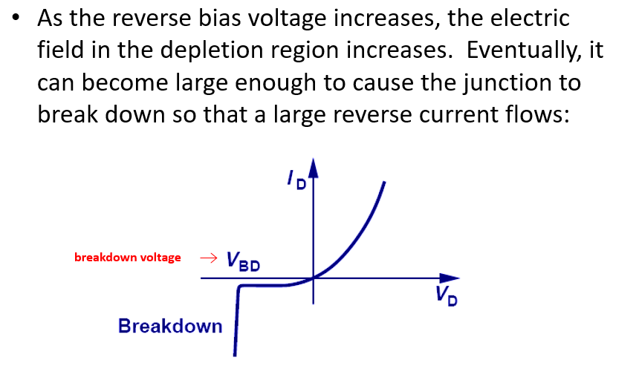
The current of a reverse biased diode (VD negative) must remain constant at I0, no matter how high the voltage value is increased. However, this current increases suddenly at a certain voltage. This voltage, which depends on the structure of the diode, is called Breakdown voltage.

Slide 13
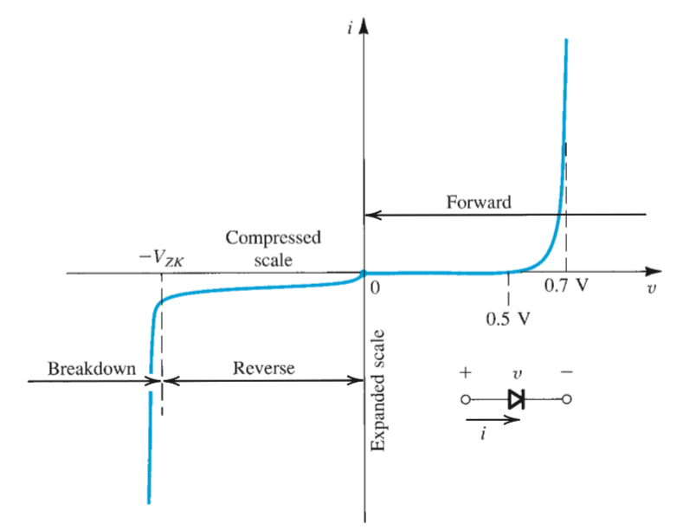
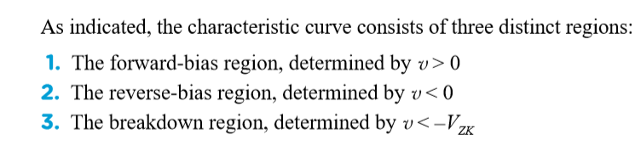

Slide 14
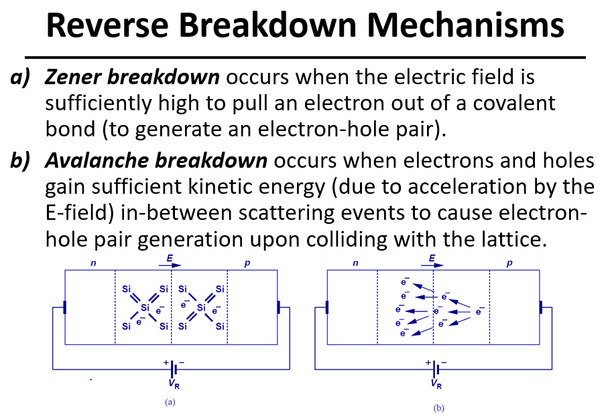

Slide 15
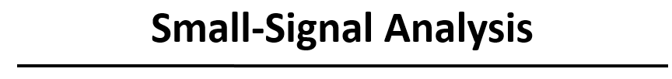
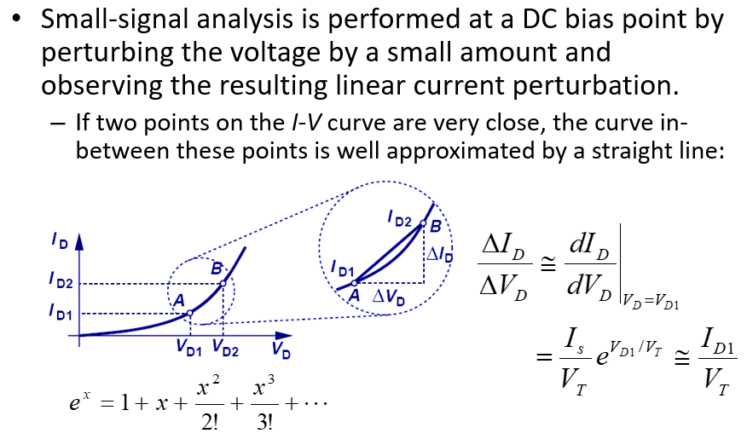

Slide 16

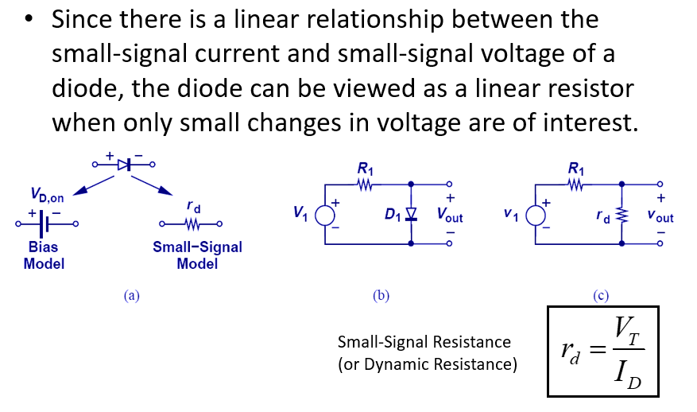

Slide 17
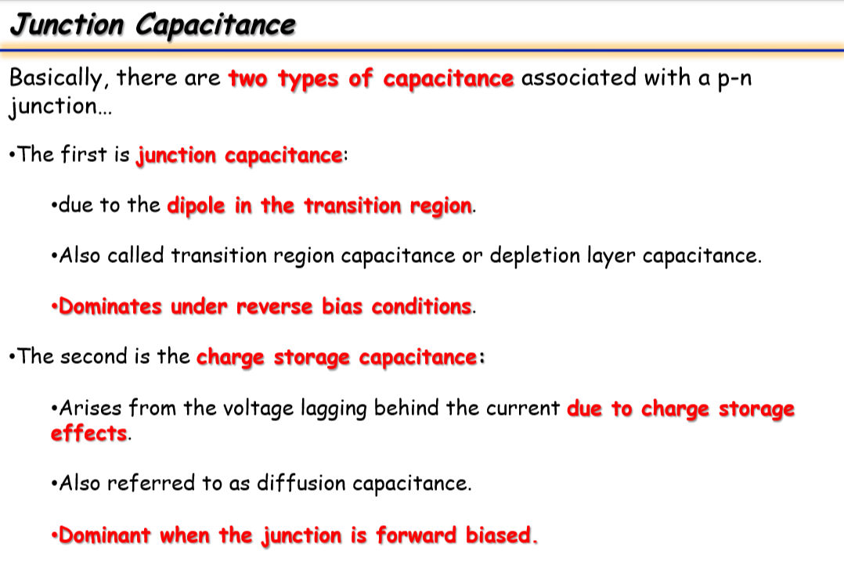

Slide 18
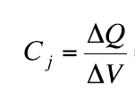
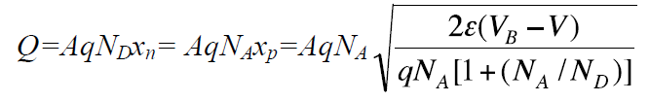
Junction Capacitance
The capacity formed by the charges changing with the applied voltages in the reverse direction is called the junction capacity.

Slide 19
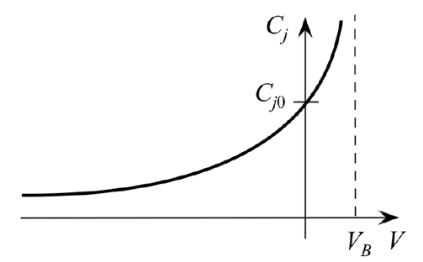
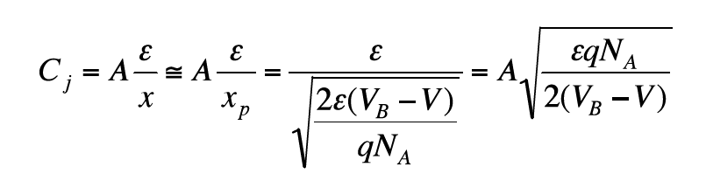
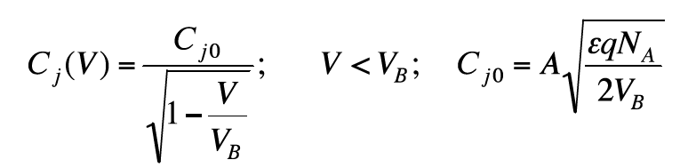
Junction Capacitance
The change of junction capacity with the voltage
The value of the capacity goes to infinity for V = VB value.
In this case, this formula is not used because the junction is in the forward region.
So the formula is only valid for negative and less than V voltage.

Slide 20
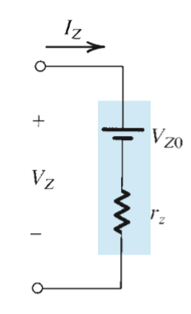


Zener Diodes

Slide 21
Example
a) Two Zener diodes on the left are identiacal with Vz=5,8V, Sketch the output voltage Vo as a function of the input voltage Vi in the range from -10V to 10V. VD=0.7V
b) What happens when the Zener diodes is taken out?
Sketch the output voltage as a function of the input voltage with only:
1. Z1
2. Z2 present.
Remember: VD =0.7 V, when dthe zener diodes are forward biased.

Slide 22
